Slide 1



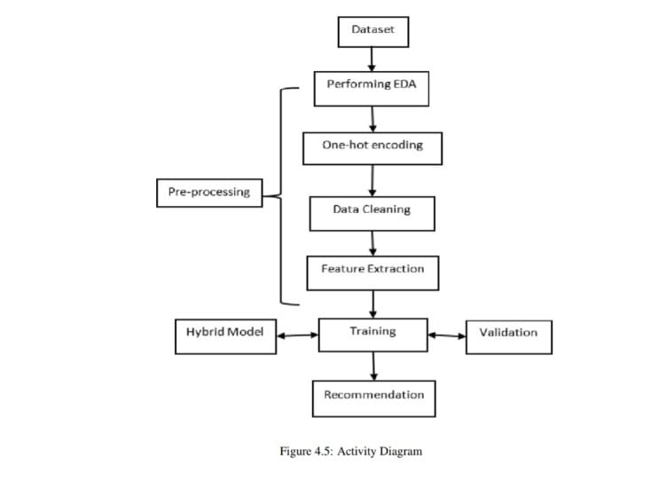
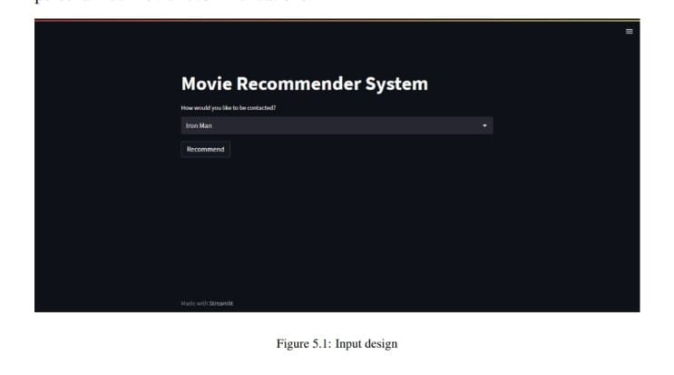
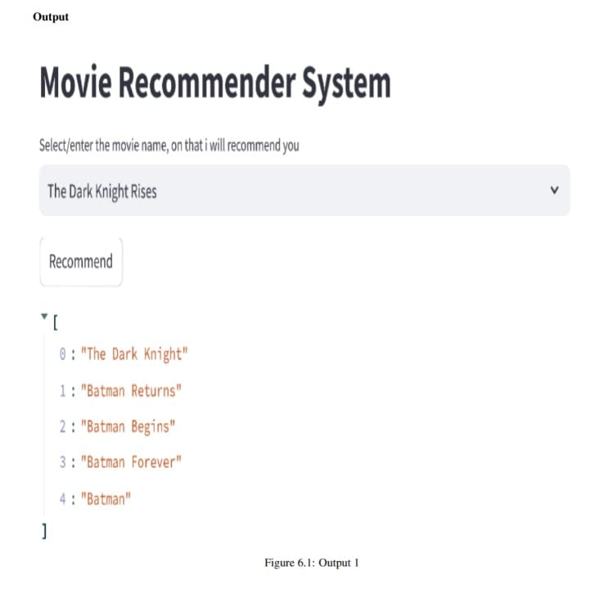
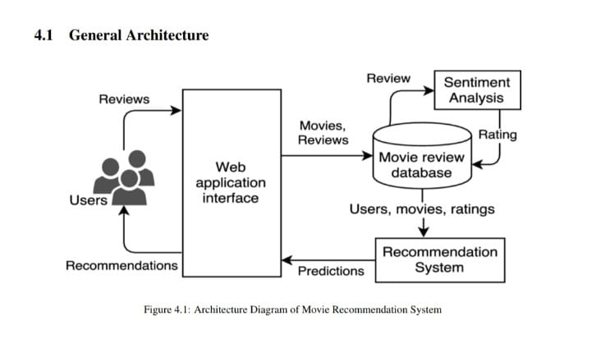
“MOVIE RECOMMENDATION SYSTEM USING MACHINE LEARNING AND NATURAL LANGUAGE PROCESSING”
Department of Information Technology
School of Computing
10214IT602 – MINOR PROJECT II
WINTER SEMESTER 2024 - 2025
ABSTRACT
INTRODUCTION
RESULTS
STANDARDS AND POLICIES
The rapid growth of digital streaming platforms has made it challenging for users to discover movies that match their interests due to the overwhelming number of choices. A Movie Recommendation System powered by Machine Learning (ML) and Natural Language Processing (NLP) helps address this issue by providing personalized suggestions based on user preferences, past viewing history, and movie-related metadata. To enhance recommendation accuracy, the system utilizes Collaborative Filtering, which analyzes user interactions to suggest movies based on similar viewing patterns, and Content-Based Filtering, which recommends movies by comparing attributes such as genre, director, and cast. A Hybrid Model integrates both approaches to overcome individual limitations and improve overall performance.
The rise of digital streaming platforms has significantly changed how people watch movies, providing access to an extensive collection of films across different genres. However, with thousands of options available, users often struggle to find movies that match their interests, leading to frustration and decision fatigue. Searching for the right movie can be time-consuming, making content discovery a major challenge. To address this issue, a Movie Recommendation System is developed to provide personalized movie suggestions based on user preferences, past viewing history, and movie-related data. This system utilizes Machine Learning (ML) and Natural Language Processing (NLP) to analyze data and predict suitable movie recommendations. Machine learning techniques help identify patterns in user behavior, allowing the system to suggest movies that align with their tastes. The system primarily relies on two methods: Collaborative Filtering and Content-Based Filtering. Collaborative Filtering suggests movies by analyzing the viewing patterns of multiple users and finding similarities among them. If two users have watched and liked similar movies in the past, the system assumes they may enjoy the same movies in the future. On the other hand, Content-Based Filtering recommends movies by comparing their features, such as genre, director, cast, and storyline, with the user’s previous choices.
The proposed movie recommendation system demonstrates high efficiency through its hybrid approach, combining Collaborative Filtering (CF) and Content- Based Filtering (CBF). By leveraging both user behavior data (ratings, preferences) and movie attributes (genre, director, cast), the system ensures accurate and diverse recommendations. The CF module identifies patterns in user behavior to suggest movies that similar users enjoyed, while the CBF module recommends movies based on content similarity. This combination enhances recommendation relevance and accuracy, providing users with more personalized suggestions.
The system ensures that all user data collected for recommendations is encrypted and securely stored. No personally identifiable information (PII) is shared with third parties. Users have the option to opt out of data collection at any time. The recommendation engine operates within GDPR compliance, ensuring transparency and user control over personal data.
METHODOLOGIES
Figure 3. Input
Figure 4. Output
Figure 1. Activity diagram
CONCLUSIONS
The architecture of a traditional movie recommendation system typically
combines Collaborative Filtering (CF) and Content-Based Filtering (CBF) to
generate personalized suggestions. User data, such as ratings and interactions,
is collected and stored in a database, forming the basis for generating
recommendations. CF analyzes user behavior and preferences by identifying
similarities between users, while CBF focuses on movie attributes such as genre,
director, and cast. The system combines the results of both methods, ranks them
based on relevance, and filters the recommendations to match user preferences.
Feedback from user interactions is then used to refine future recommendations,
creating an adaptive system.
A Movie Recommendation System using Machine Learning (ML) and Natural Language Processing (NLP) improves movie discovery by providing personalized suggestions. By combining Content-Based Filtering (TF-IDF), Collaborative Filtering (SVD), and NLP techniques (Word2Vec, Sentiment Analysis), the system analyzes user preferences, ratings, and movie descriptions to generate accurate recommendations.
TEAM MEMBER DETAILS
VTU 23130/N.JITHENDRA
VTU 23132/N.YASASWINI
1.9492312439
2.9347191710
vtu23130@veltech.edu.in 2.vtu23132@veltech.edu.in
ACKNOWLEDGEMENT
Supervisor Name : Dr.M.Dhilsath Fathima, M.E.,Ph.D.,
Contact No : 86681 22854
Mail ID : drdhilsathfathimam@veltech.edu.in
Figure 2. Architecture diagram

